Slide 1

AUDIT MANAGEMENT SYSTEM
Team Members
Sumanth N : 2174465
Sheethal Madhu :2173857
Nidhi R : 2174627
Dhruv Mehta : 2173781
Mandeep Singh :2174337

Slide 2
Table of contents
●Problem statement
●Approach
Plan of the project
●Requirements
●System Architecture
●Microservices and Modules
●Screenshots

Slide 3
Problem Statement
A leading Supply chain Management Organization wants to automate the Audit processing
The Organization want us to develop an audit management system and requested to deploy them in AWS. They wanted us to build UI on Angular .

Slide 4
Approach toward the project
1. SRS document was gone through.
2. Developing microservices and UI
3. Sharing the work on GitHub.
4.Integration of the services and UI
5.Deployement on AWS

Slide 5
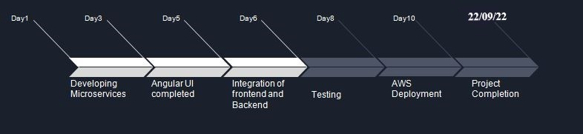
Plan of the project

Slide 6
Requirements
Hardware requirements
Pc / Laptop - 8 GB RAM preferably
Software requirements
Eclipse - Latest version
Node JS
Lombok
Visual studio code
AWS access

Slide 7
Microservices
Authorization
Checklist
Benchmark
Severity

Slide 8
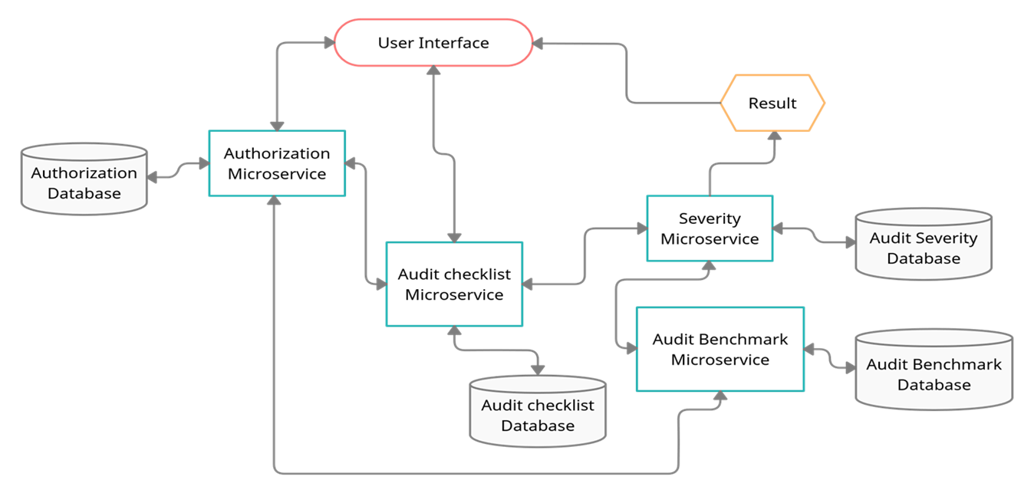
System Architecture

Slide 9

Backend Modules

Slide 10
Audit Authorization
Security Requirements
Authenticate the user based on his credentials.
Create JWT
Have the token expired after specific amount of time say 30 minutes
Has anonymous access to get the token detail

Slide 11
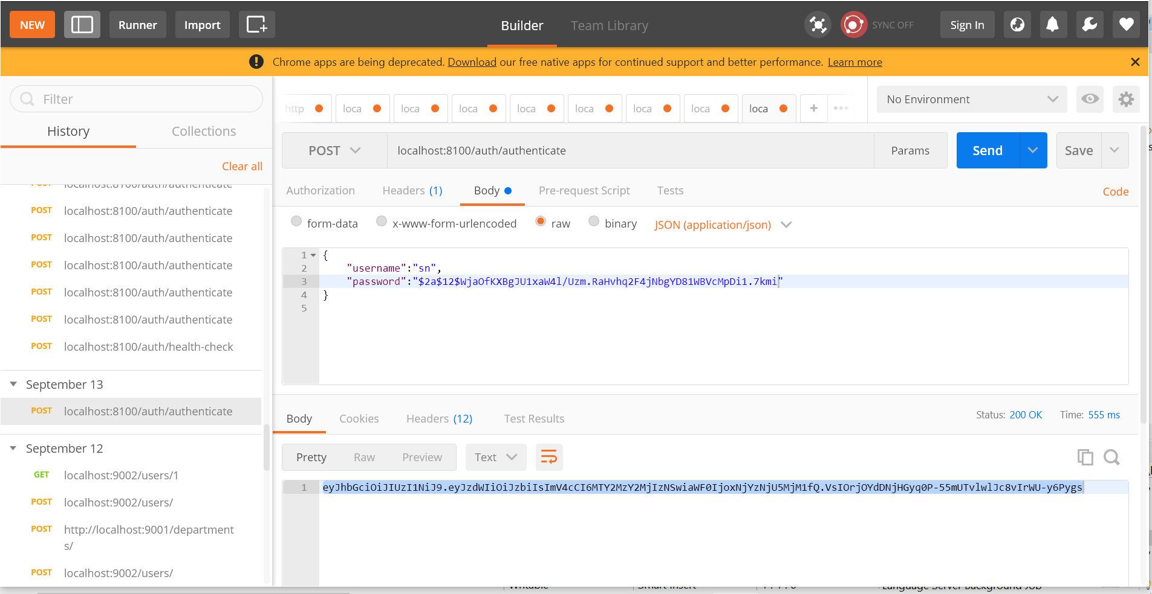
localhost:8100/auth/authenticate

Slide 12
Audit Checklist
Functions :
Provides a list of YES/NO type of questions for the audit based on the audit type
This will be consumed by the User interface the display the questions on the portal

Slide 13

Audit Checklist
Functional Requirements
The intent of this Microservice is to provide the list of questions for Audit checklist.
Post Authorization using JWT, the questions will be used to display the questions on the Web UI
REST End Points
Audit Checklist Microservice
GET: /AuditCheckListQuestions (Input: AuditType | Output: List of questions)

Slide 14
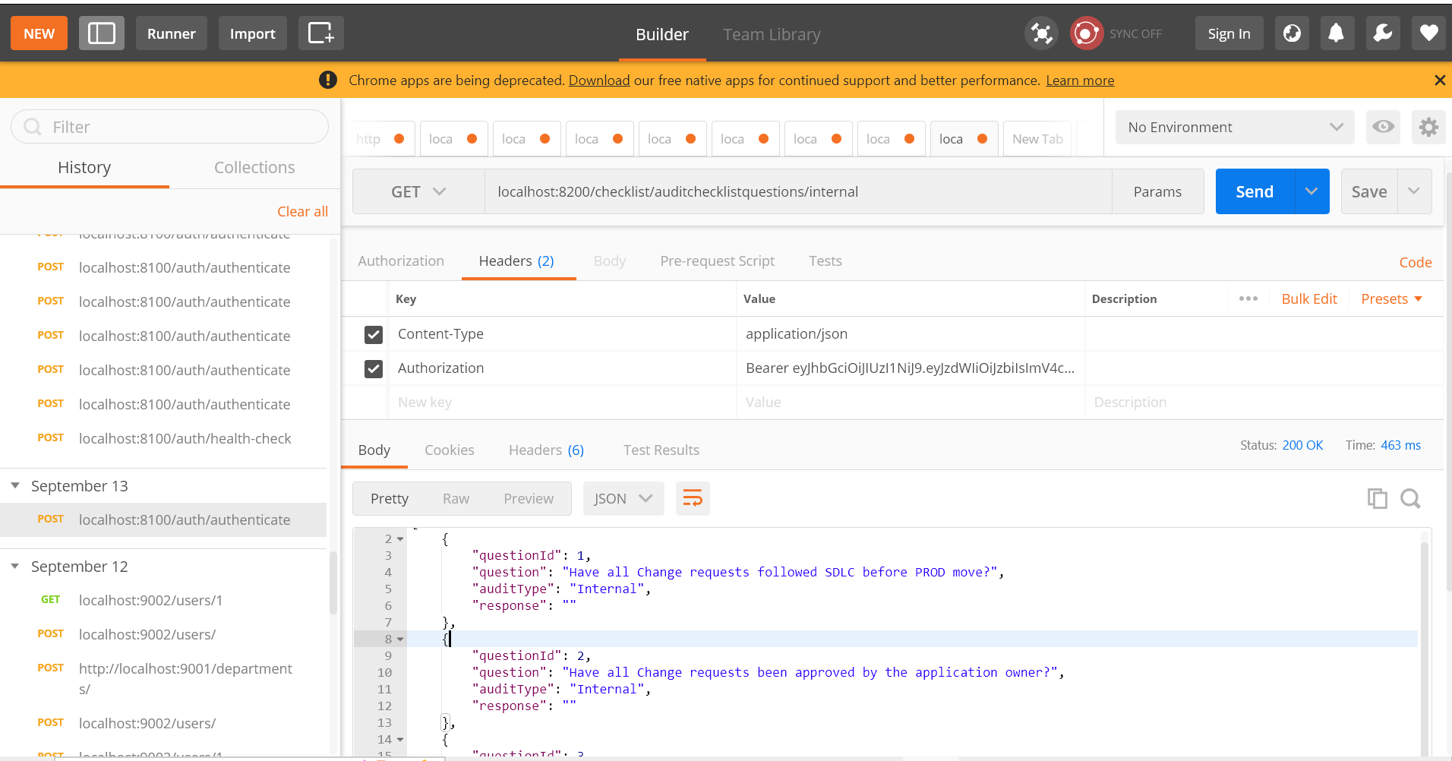
Localhost:8200/checklist/auditchecklistquestion/internal

Slide 15
Audit Benchmark
Audit benchmark Module is a Middleware Microservice that performs the following operations:
Provides the acceptable number of answers with NO as the answer for various audit types

Slide 16
Functional Requirements
AuditSeverity Microservice interacts with AuditBenchmark Microservice. AuditBenchmark Microservice allows the following operations:
This Microservice should provide the acceptable benchmark value for every audit type. It should return a Dictionary of values with AuditType and Acceptable benchmark value of number of questions whose answers can be NO
Audit type: Internal; Acceptable value of NO: 3
Audit type: SOX; Acceptable value of NO: 1

Slide 17
REST End Points
GET: /AuditBenchmark (Input: None | Output: List of AuditBenchmark)
Trigger – Can be invoked from AuditSeverity Microservice
This microservice will have only 1 REST endpoint to return the benchmark value of audit types

Slide 18
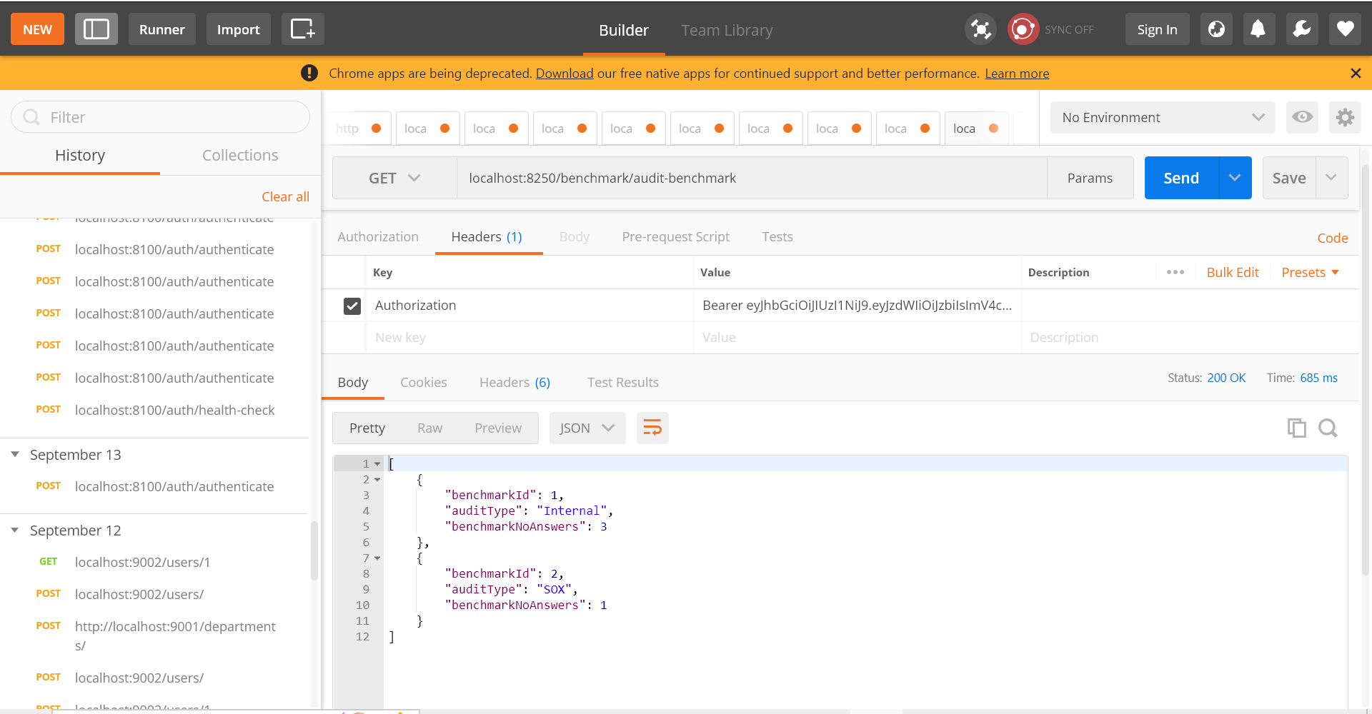
Localhost:8250/benchmark/audit-benchmark

Slide 19
Audit Severity
Gets the audit response and analyzes the project execution status.
Gets the Audit benchmark detail from Microservice, compares the current project data.
Determines the project execution status and the duration in which remedial action should be taken.

Slide 20
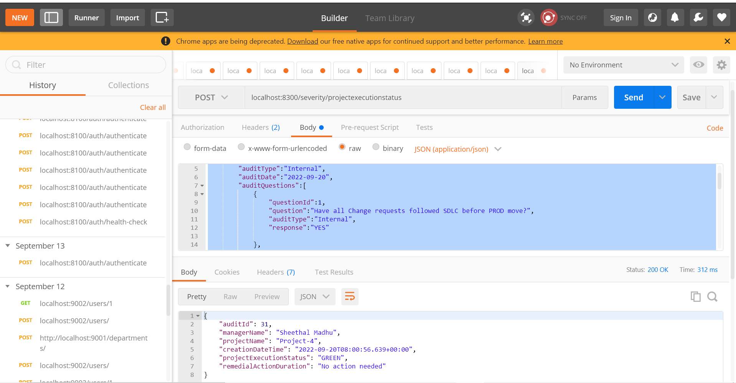
Localhost:8300/severity/projectexecutionstatus

Slide 21
Frontend Module
● Audit management Portal must allow a member to Login.
● After logged in, Choose the audit type to view the list of audit checklist questions
● Let the project manager provide answers to the questions
● Invoke the Audit Severity Microservice to determine the project execution status
● Display the result on the Web UI

Slide 22
Output

Slide 23
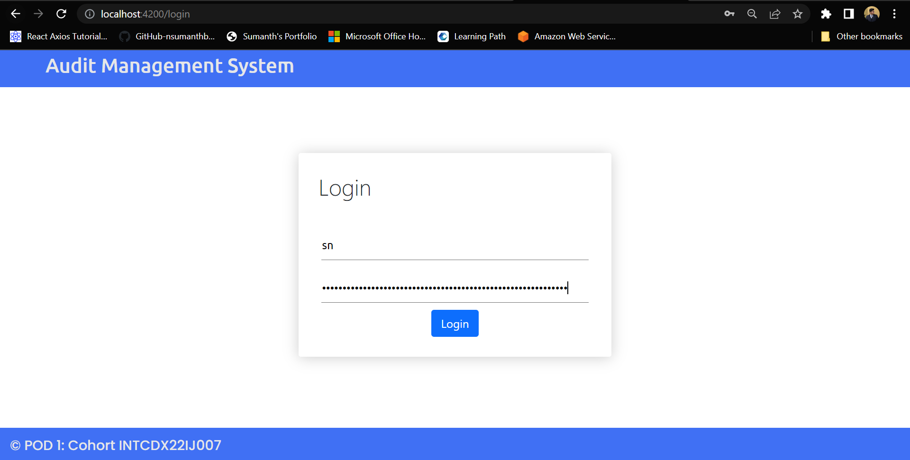

Slide 24
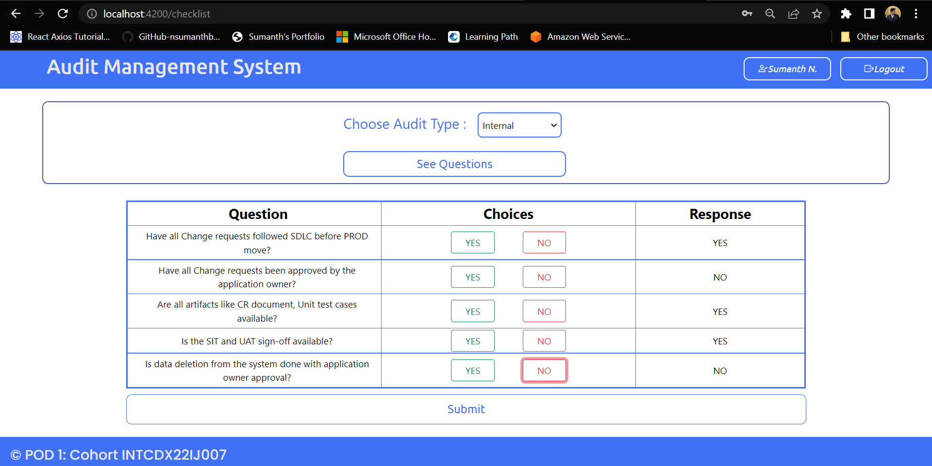

Slide 25
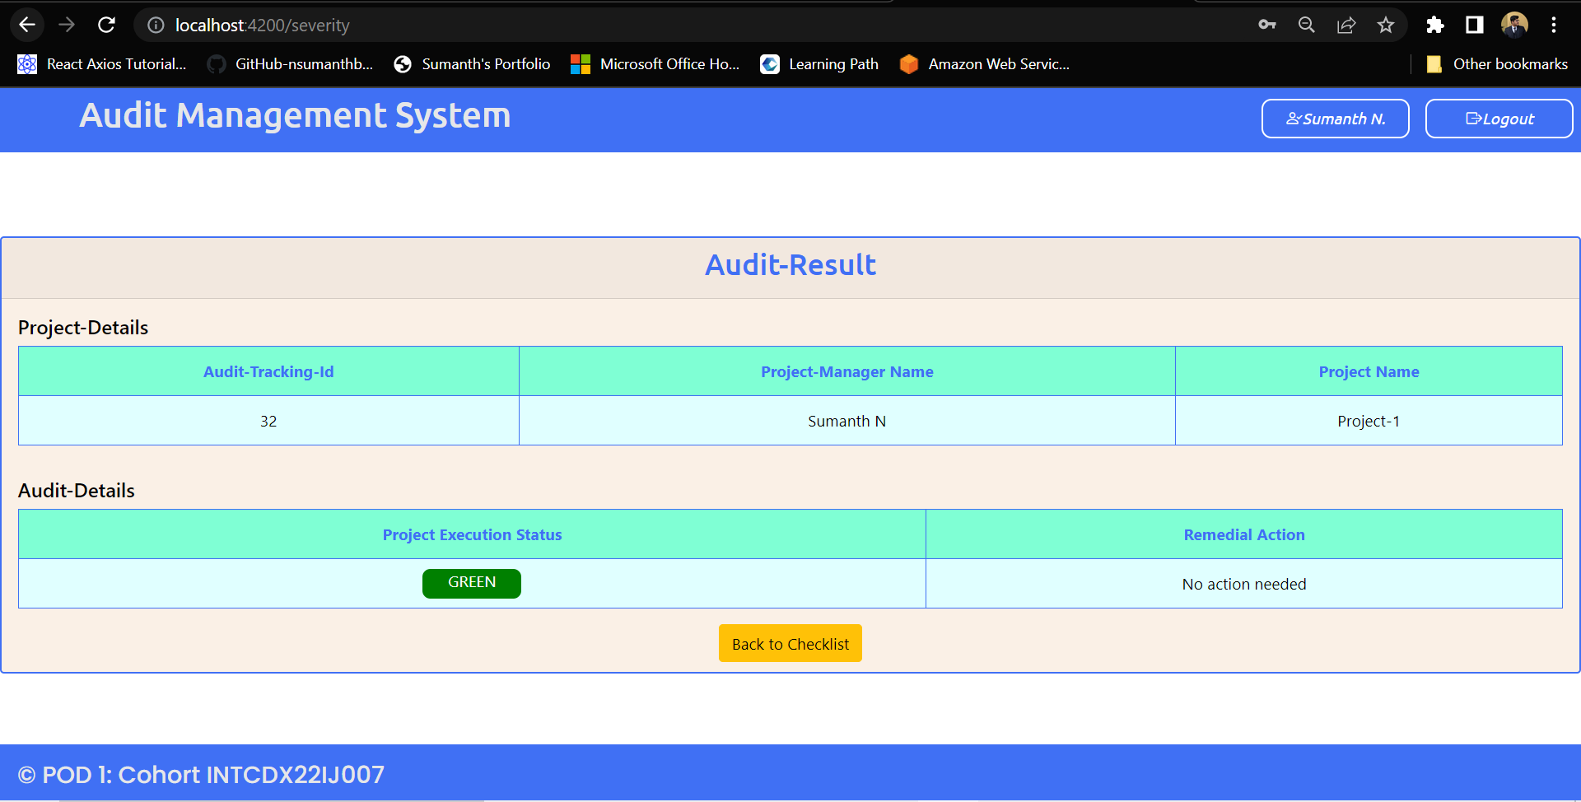

Slide 26
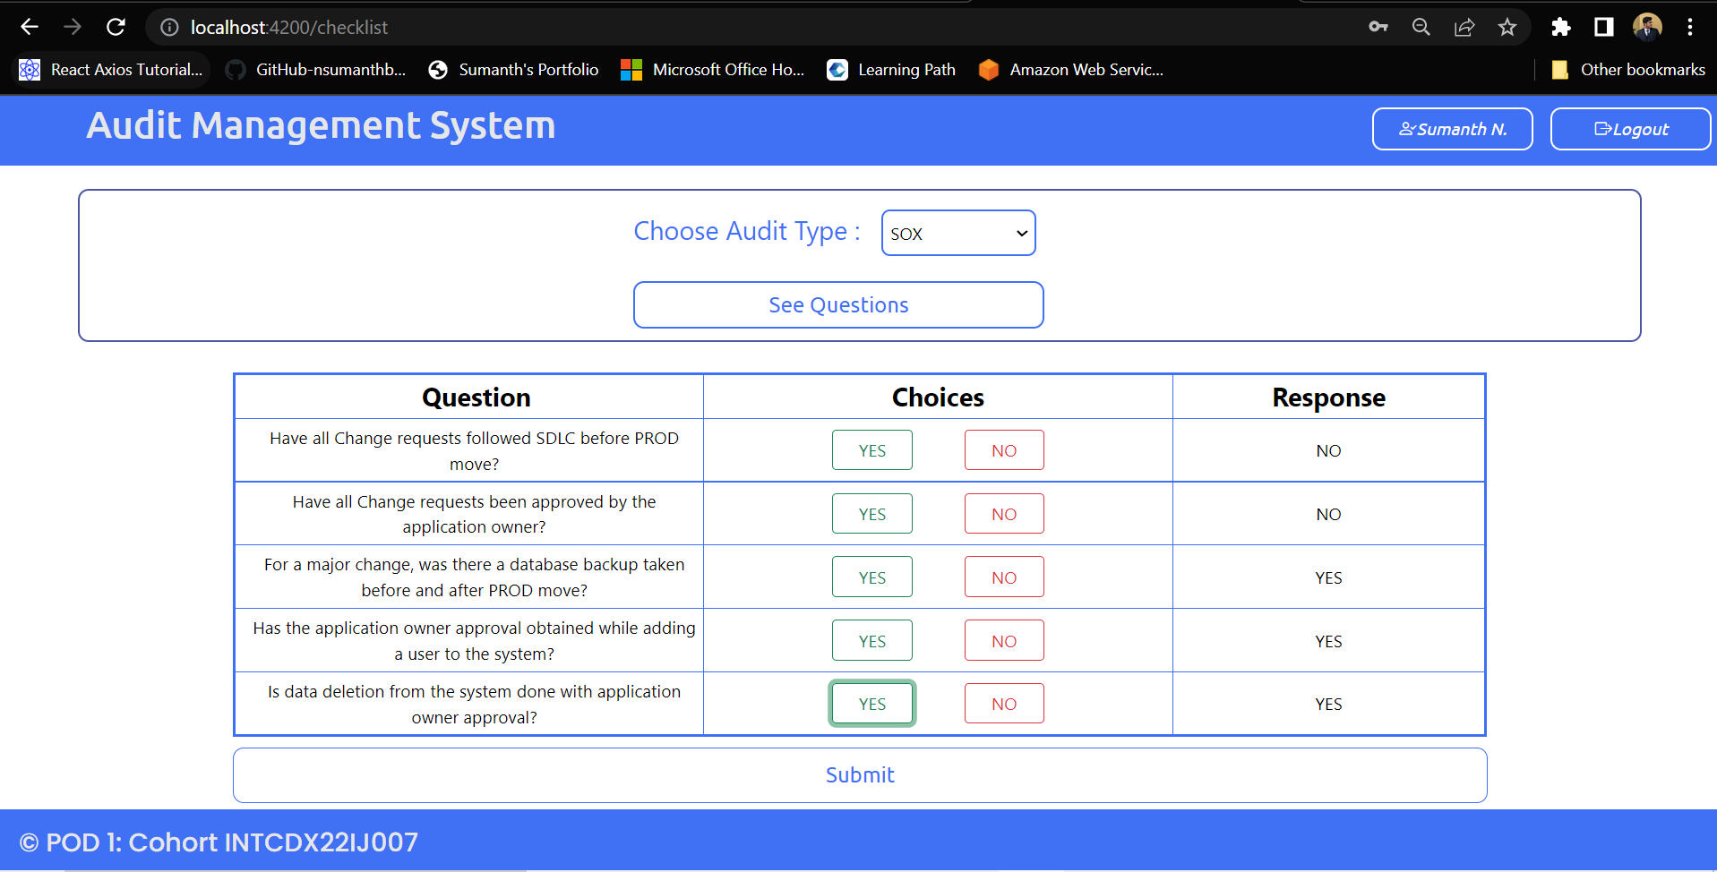

Slide 27
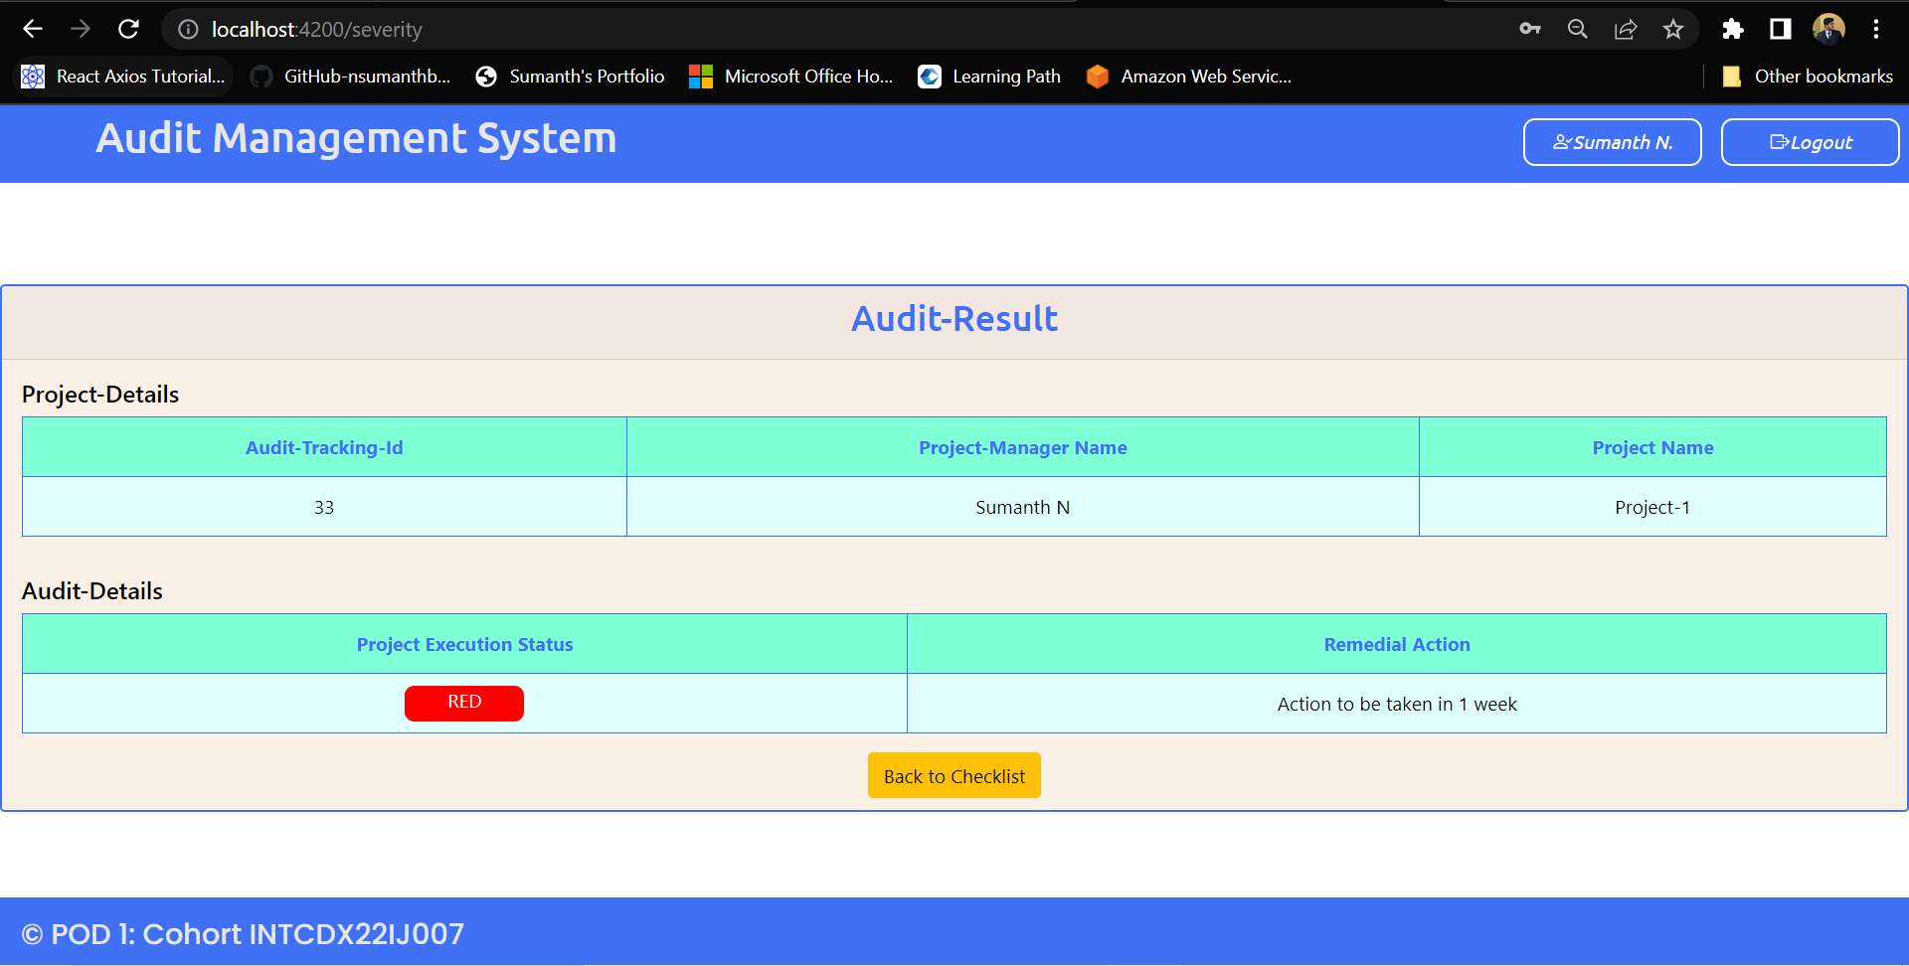

Slide 28
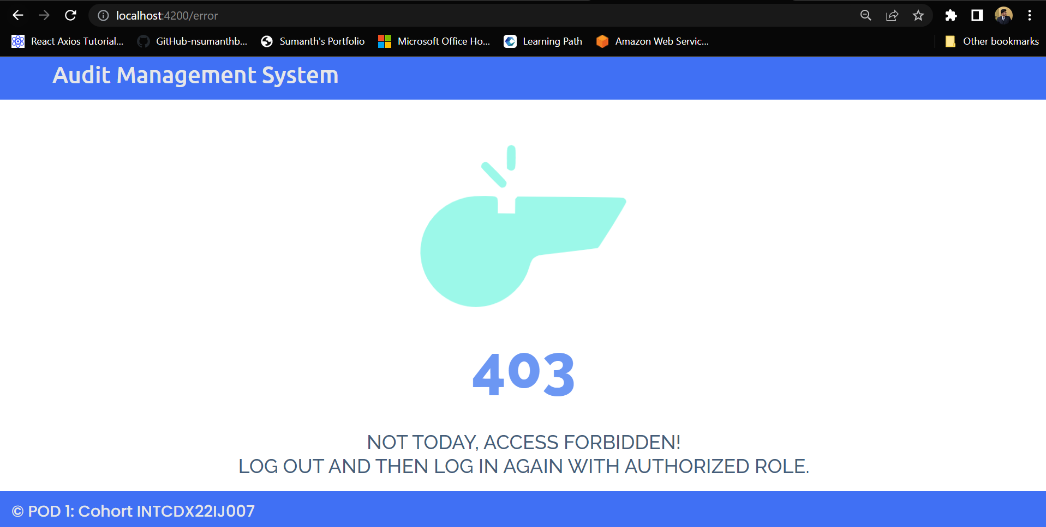

Slide 29
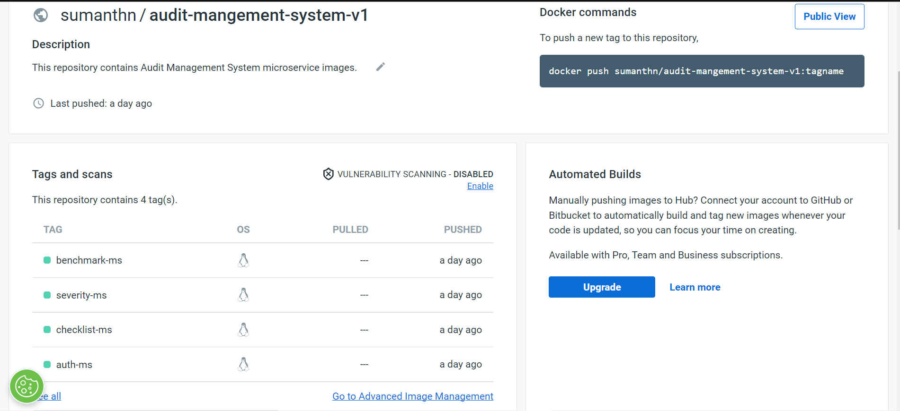

Slide 30
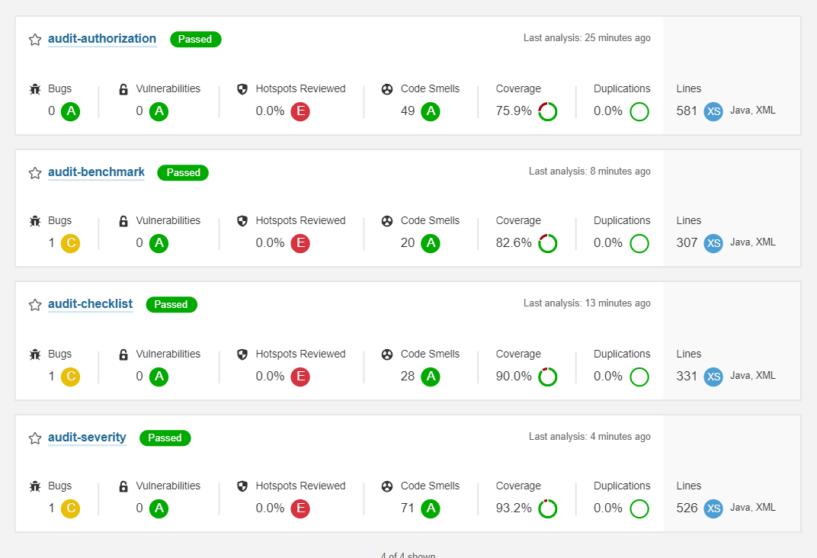

Slide 31
Thank You

